Slide 1
Find Closest Value in BST
Binary Search Tree
Chaw Thiri San (23/06/25)

Slide 2
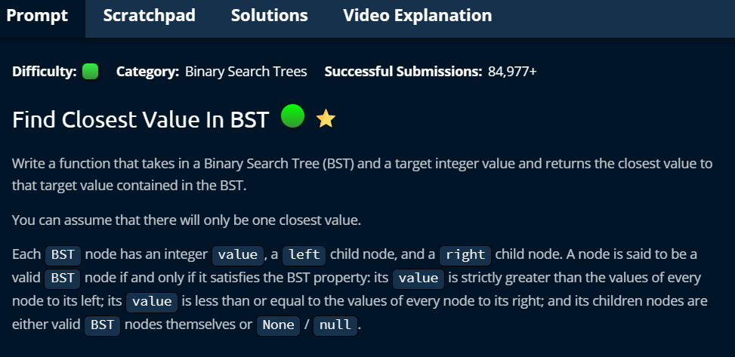

Slide 3
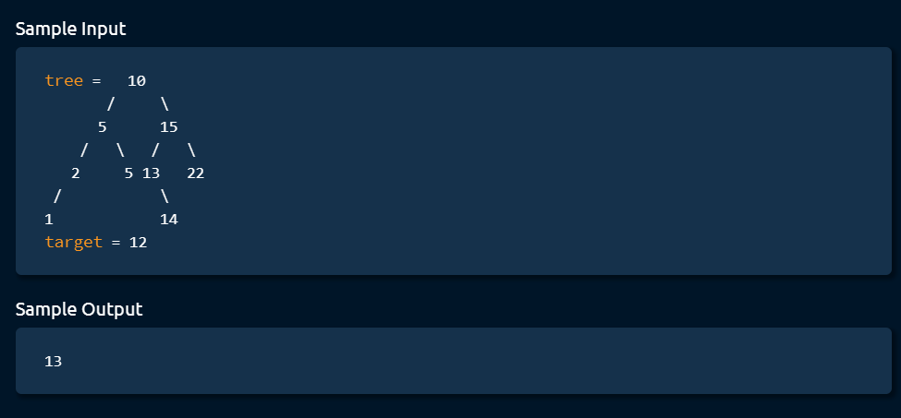

Slide 4


Slide 5


Slide 6


Slide 7


